Slide 1

Methods of Proof

Slide 2
This Lecture
Now we have learnt the basics in logic.
We are going to apply the logical rules in proving mathematical theorems.
Direct proof
Contrapositive
Proof by contradiction
Proof by cases

Slide 3
Basic Definitions
An integer n is an even number
if there exists an integer k such that n = 2k.
An integer n is an odd number
if there exists an integer k such that n = 2k+1.

Slide 4
Proving an Implication
Goal: If P, then Q. (P implies Q)
Method 1: Write assume P, then show that Q logically follows.
The sum of two even numbers is even.
Proof
x = 2m, y = 2n
x+y = 2m+2n
= 2(m+n)

Slide 5
Direct Proofs
The product of two odd numbers is odd.
Proof
x = 2m+1, y = 2n+1
xy = (2m+1)(2n+1)
= 4mn + 2m + 2n + 1
= 2(2mn+m+n) + 1.
If m and n are perfect square, then m+n+2√(mn) is a perfect square.
Proof
m = a² and n = b² for some integers a and b
Then m + n + 2√(mn) = a² + b² + 2ab
= (a + b)²
So m + n + 2√(mn) is a perfect square.

Slide 6
This Lecture
Direct proof
Contrapositive
Proof by contradiction
Proof by cases
P -> Q
~p <- ~q
~q->~p

Slide 7
Proving an Implication
Goal: If P, then Q. (P implies Q)
Method 1: Write assume P, then show that Q logically follows.
Claim:
If r is irrational, then √r is irrational.
How to begin with?
What if I prove “If √r is rational, then r is rational”, is it equivalent?
Yes, this is equivalent, because it is the contrapositive of the statement,
so proving “if P, then Q” is equivalent to proving “if not Q, then not P”.

Slide 8
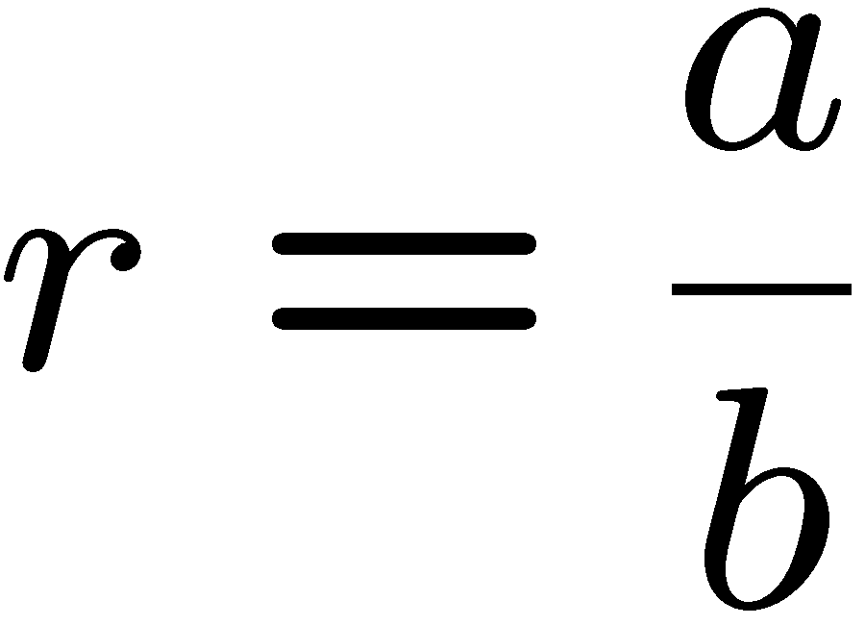
Rational Number
R is rational ⬄ there are integers a and b such that
numerator
and b ≠ 0.
denominator
Is 0.281 a rational number?
Is 0 a rational number?
If m and n are non-zero integers, is (m+n)/mn a rational number?
Is the sum of two rational numbers a rational number?
Is x=0.12121212…… a rational number?
Yes, 281/1000
Yes, 0/1
Yes
Yes, a/b+c/d=(ad+bc)/bd
Note that 100x-x=12, and so x=12/99.

Slide 9
Proving the Contrapositive
Goal: If P, then Q. (P implies Q)
Method 2: Prove the contrapositive, i.e. prove “not Q implies not P”.
Claim:
If r is irrational, then √r is irrational.
Proof:
We shall prove the contrapositive –
“if √r is rational, then r is rational.”
Since √r is rational, √r = a/b for some integers a,b.
So r = a²/b². Since a,b are integers, a²,b² are integers.
Therefore, r is rational.
Q.E.D.
(Q.E.D.)
"which was to be demonstrated",
or “quite easily done”. ☺

Slide 10
Proving an “if and only if”
Goal: Prove that two statements P and Q are “logically equivalent”,
that is, one holds if and only if the other holds.
Example: For an integer n, n is even if and only if n² is even.
Method 1a: Prove P implies Q and Q implies P.
Method 1b: Prove P implies Q and not P implies not Q.
Method 2: Construct a chain of if and only if statement.

Slide 11
Proof the Contrapositive
For an integer n, n is even if and only if n² is even.
Method 1a: Prove P implies Q and Q implies P.
Statement: If n is even, then n² is even
Proof:
n = 2k
n² = 4k²
Statement: If n² is even, then n is even
Proof:
n² = 2k
n = √(2k)
??

Slide 12
Proof the Contrapositive
For an integer n, n is even if and only if n² is even.
Method 1b: Prove P implies Q and not P implies not Q.
Statement: If n² is even, then n is even
Contrapositive: If n is odd, then n² is odd.
Proof (the contrapositive):
Since n is an odd number, n = 2k+1 for some integer k.
So n² = (2k+1)²
= (2k)² + 2(2k) + 1
= 2(2k² + 2k) + 1
So n² is an odd number.

Slide 13
This Lecture
Direct proof
Contrapositive
Proof by contradiction
Proof by cases

Slide 14
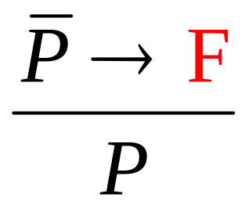
Proof by Contradiction
To prove P, you prove that not P would lead to ridiculous result,
and so P must be true.

Slide 15

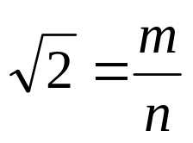
Proof by Contradiction
Theorem: is irrational.
Proof (by contradiction):
Suppose was rational.
Choose m, n integers without common prime factors (always possible) such that
Show that m and n are both even, thus having a common factor 2,
a contradiction!

Slide 16

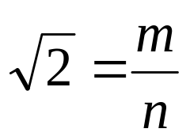

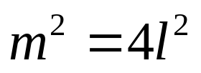
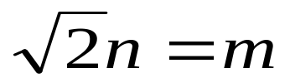
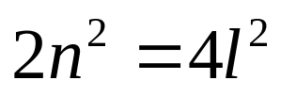

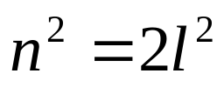
Proof by Contradiction
Theorem: is irrational.
Proof (by contradiction):
Want to prove both m and n are even.
so can assume
so m is even.
so n is even.
Recall that m is even if and only if m² is even.

Slide 17
This Lecture
Direct proof
Contrapositive
Proof by contradiction
Proof by cases

Slide 18
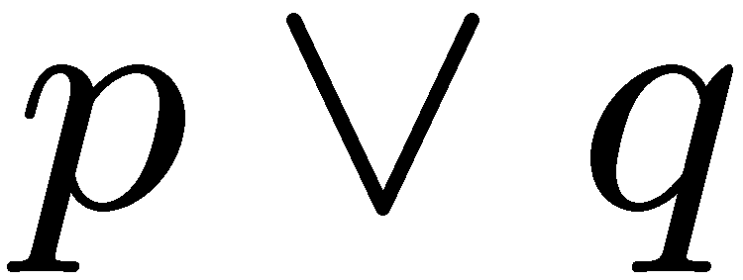
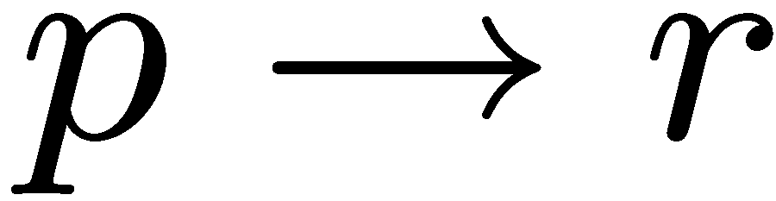
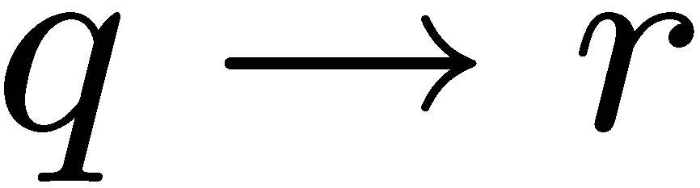
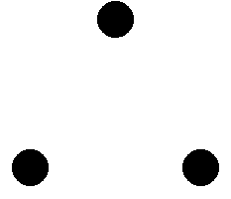

Proof by Cases
e.g. want to prove a nonzero number always has a positive square.
x is positive or x is negative
if x is positive, then x² > 0.
if x is negative, then x² > 0.
x² > 0.

Slide 19
The Square of an Odd Integer
Idea 0: find counterexample.
3² = 9 = 8+1, 5² = 25 = 3x8+1 …… 131² = 17161 = 2145x8 + 1, ………
Idea 1: prove that n² – 1 is divisible by 8.
n² – 1 = (n-1)(n+1) = ??…
Idea 2: consider (2k+1)²
(2k+1)²
= 4k²+4k+1 = 4(k²+k)+1
If k is even, then both k² and k are even, and so we are done.
If k is odd, then both k² and k are odd, and so k²+k even, also done.

Slide 20
Summary
We have learnt different techniques to prove mathematical statements.
Direct proof
Contrapositive
Proof by contradiction
Proof by cases
Next time we will focus on a very important technique, proof by induction.

